Slide 1
Requirement Engineering Process
-Goutham

Slide 2
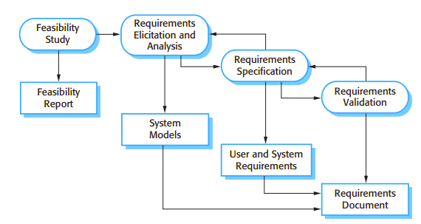
4 activities of RE

Slide 3
Topics to be covered
01
Requirements elicitation and analysis
02
General model of requirement process
03
Requirements validation
04
Requirements Review
05
Requirement management

Slide 4
01
Requirements elicitation and analysis

Slide 5
In this activity software engineers work with customers and system end-users to find out about the application domain, what services the system should provide, the required performance of the system, hardware constraints, and so on.
Requirements elicitation and analysis may involve a variety of people in an organization.
The term stakeholders used to refer to any person or group who will be affected by the system, directly or indirectly. Stakeholders include end-users who interact with the system and everyone else in an organization that may be affected by its installation. Other system stakeholders may be engineers who are developing or maintaining related systems, business managers, domain experts and trade union representatives.

Slide 6
Challenges while Eliciting and understanding stakeholder requirements

Slide 7
Stakeholders don’t know what they want / make unrealistic demands
Reason:
Stakeholders may only have a vague idea or ask for features without knowing cost/feasibility.
Example:
A hospital wants a smart AI doctor system that can diagnose all diseases automatically.
The requirement is too general and unrealistic, because such a system would require massive data, advanced AI, legal approvals, and is far too expensive.
The requirements engineer must refine this into realistic modules (e.g., AI-assisted diagnosis for specific symptoms).

Slide 8
Stakeholders use their own terms / implicit knowledge
Reason:
Users describe requirements in domain-specific terms that engineers don’t understand.
Example:
In a banking system, a loan officer says:
We need to support floating EMI with step-up repayment and balloon payments.
The software engineer may not understand EMI, step-up repayment, or balloon payment.
They must learn domain terms or ask clarifying questions to capture the real requirement.

Slide 9
Different stakeholders, conflicting requirements
Reason:
Multiple groups of stakeholders have different and sometimes contradictory needs.
Example:
For a university portal system:
    Students want : easy login, course registration, mobile app access.
    Professors want : flexible grading system, research publication integration.
    Administration wants: strict attendance monitoring and fee tracking.
    Students want minimal attendance tracking, while administration demands detailed attendance logs. Requirements engineers must negotiate and prioritize.

Slide 10
Political factors influence requirements
Reason:
Managers or powerful stakeholders push for features that benefit them personally, not necessarily the organization.
Example:
In a company HR system, a senior manager insists on having a special admin dashboard with access to all employee performance data.
The actual business need is just performance reports for HR, but the manager wants more access to increase personal influence.
Requirements engineers must carefully handle such political demands while balancing fairness and security.

Slide 11
Dynamic business environment / changing requirements
Reason:
Business priorities and external environment change during analysis.
Example:
A retail e-commerce company starts developing a system for offline in- store sales tracking. Midway through development, COVID-19 pandemic hits
The focus shifts to online e-commerce, digital payments, and home delivery tracking.
New requirements emerge, old ones lose importance. Requirements engineers must adapt quickly to evolving needs.

Slide 12
General elicitation and analysis process model
02

Slide 13
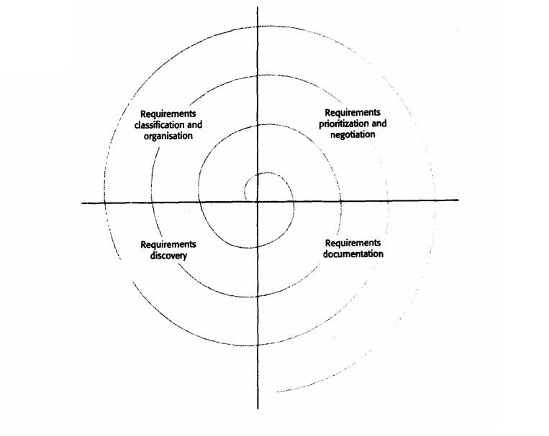
Each organization will have its own version or instantiation of this general model, depending on local factors such as the expertise of the staff, the type of system being developed and the standards used. These activities within a spiral so that the activities are interleaved as the process proceeds from the inner to the outer rings of the spiral.
Requirements elicitation and analysis is not a one-time linear activity.
It is an iterative cycle with continuous feedback.
Starts with requirements discovery and ends with requirements documentation.
With each iteration, the analyst’s understanding improves and requirements become clearer.

Slide 14
Requirements Discovery
Interacting with stakeholders to collect requirements through interviews,
workshops, observation, document analysis.
Includes domain requirements from stakeholders and existing documentation.
Example:
For a hospital management system, during discovery:
Doctors : We need quick access to patient history before treatment.
Nurses : We want alerts when patients miss medication.
Existing policy documents require: All patient records must be stored securely
for 10 years.

Slide 15
Requirements Classification and Organisation
Taking raw, unstructured requirements and grouping them into logical clusters
Helps reduce duplication and make sense of scattered requirements.
Example
Patient Management: Patient history, secure storage, discharge details.
Alerts & Notifications: Medication alerts, appointment reminders.
Access Control: Doctors vs nurses vs admin roles.

Slide 16
Requirements Prioritisation and Negotiation
Different stakeholders may have conflicting requirements.
This step is about prioritizing what’s most important and negotiating trade-offs.
Example:
Doctors want voice-based dictation for notes (high priority).
IT staff say this will increase cost and delay system launch.
Negotiation: Implement basic text-based notes first , add voice dictation later
if budget permits.

Slide 17
Requirements Documentation
Recording requirements in a clear, usable form for the next cycle of analysis or
design. It Can be formal (SRS document) or informal (tables, user stories, cards in Agile).
Example :
Formal SRS entry:
  REQ-01: The system shall generate medication alerts for each patient
  according to the doctor’s prescription schedule.
Agile user story (informal):
  As a nurse, I want to get automatic alerts when a patient misses a dose,
  so I can remind them.

Slide 18
03
Requirement
Validation

Slide 19
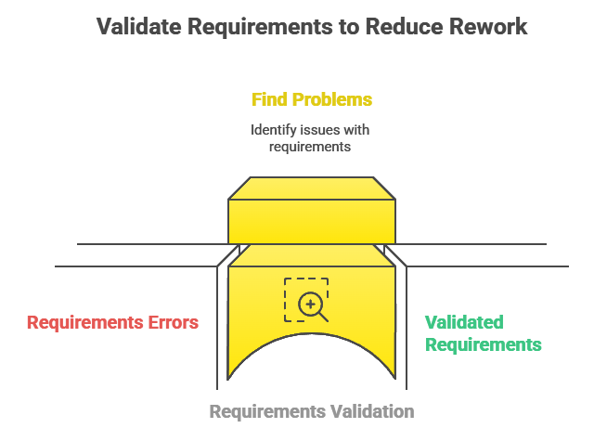
Ensures requirements define the system the customer actually wants.
Focused on detecting problems in requirements.
Importance:
  Errors in requirements documents are costly if discovered late.
  Fixing requirement errors is more expensive than fixing design or coding errors because if Requirement changes it will directly affect design, implementation, and testing.

Slide 20
validation process checks to be carried on the requirements document
A user may think that a system is needed to perform certain functions. However, further thought and analysis may identify additional or different functions that are required. Systems have diverse stakeholders with distinct needs, and any set of requirements is inevitably a compromise across the stakeholder community.
01
02
03
04
05
To reduce the potential for dispute between customer and contractor, systt:m requirements should always be written so that they are verifiable. This means that you should be able to write a set of tests that can demonstrate that the delivered system meets each specified requirement.
Using knowledgt: of existing technology, the requirements should be checked to ensure that they could actually be implemented. These checks should also take account of the budget and schedule for the system developmen':.
Validity
Check
Consistency
Check
Completeness
Check
Realism
Check
Verifiability
Requirements in the document should not conflict. That is, there should be no contradictory constraints or descriptions of the same system function.
The requirements document should include requirements, which define all functions, and constraints intended by the system user.
Example
A doctor may ask for a feature to store patient records. After analysis, you realize nurses also need medication scheduling and administrators need billing features. The system must include all these valid needs, not just the doctor’s request.
In an online banking app, one requirement says: Users must authenticate with OTP for every login.
Another says: Users can enable auto-login for faster access.
These conflict you can’t have both OTP every time and auto-login at the same time.
In an e-commerce website, requirements mention: “Users can add items to cart and proceed to checkout.
But they forget to mention Users must be able to remove items from the cart.
This is an incomplete requirement set real systems need both add and remove functionality.
A startup mobile app project requires: App must provide real-time translation of video calls into 50 languages with 99% accuracy.
With current tech, budget, and 6-month schedule, this is unrealistic.
The requirement should be revised to something achievable, text translation in 5–10 languages.
A requirement says: The website should be user-friendly. This is vague and not verifiable.
Instead, it should say: The website should load within 3 seconds on a 4G network. This is verifiable by performance tests.

Slide 21
validation process checks to be carried on the requirements document
A user may think that a system is needed to perform certain functions. However, further thought and analysis may identify additional or different functions that are required. Systems have diverse stakeholders with distinct needs, and any set of requirements is inevitably a compromise across the stakeholder community.
01
02
03
04
05
To reduce the potential for dispute between customer and contractor, systt:m requirements should always be written so that they are verifiable. This means that you should be able to write a set of tests that can demonstrate that the delivered system meets each specified requirement.
Using knowledgt: of existing technology, the requirements should be checked to ensure that they could actually be implemented. These checks should also take account of the budget and schedule for the system developmen':.
Validity
Check
Consistency
Check
Completeness
Check
Realism
Check
Verifiability
Requirements in the document should not conflict. That is, there should be no contradictory constraints or descriptions of the same system function.
The requirements document should include requirements, which define all functions, and constraints intended by the system user.
Example
In an online banking app, one requirement says: Users must authenticate with OTP for every login.
Another says: Users can enable auto-login for faster access.
These conflict you can’t have both OTP every time and auto-login at the same time.
In an e-commerce website, requirements mention: “Users can add items to cart and proceed to checkout.
But they forget to mention Users must be able to remove items from the cart.
This is an incomplete requirement set real systems need both add and remove functionality.
A startup mobile app project requires: App must provide real-time translation of video calls into 50 languages with 99% accuracy.
With current tech, budget, and 6-month schedule, this is unrealistic.
The requirement should be revised to something achievable, text translation in 5–10 languages.
A requirement says: The website should be user-friendly. This is vague and not verifiable.
Instead, it should say: The website should load within 3 seconds on a 4G network. This is verifiable by performance tests.

Slide 22
validation process checks to be carried on the requirements document
A user may think that a system is needed to perform certain functions. However, further thought and analysis may identify additional or different functions that are required. Systems have diverse stakeholders with distinct needs, and any set of requirements is inevitably a compromise across the stakeholder community.
02
03
04
05
To reduce the potential for dispute between customer and contractor, systt:m requirements should always be written so that they are verifiable. This means that you should be able to write a set of tests that can demonstrate that the delivered system meets each specified requirement.
Using knowledgt: of existing technology, the requirements should be checked to ensure that they could actually be implemented. These checks should also take account of the budget and schedule for the system developmen':.
Requirements in the document should not conflict. That is, there should be no contradictory constraints or descriptions of the same system function.
The requirements document should include requirements, which define all functions, and constraints intended by the system user.
Consistency
Check
Completeness
Check
Realism
Check
Verifiability
Example
In an e-commerce website, requirements mention: Users can add items to cart and proceed to checkout.
But they forget to mention Users must be able to remove items from the cart.
This is an incomplete requirement set real systems need both add and remove functionality.
A startup mobile app project requires: App must provide real-time translation of video calls into 50 languages with 99% accuracy.
With current tech, budget, and 6-month schedule, this is unrealistic.
The requirement should be revised to something achievable, text translation in 5–10 languages.
A requirement says: The website should be user-friendly. This is vague and not verifiable.
Instead, it should say: The website should load within 3 seconds on a 4G network. This is verifiable by performance tests.

Slide 23
validation process checks to be carried on the requirements document
A user may think that a system is needed to perform certain functions. However, further thought and analysis may identify additional or different functions that are required. Systems have diverse stakeholders with distinct needs, and any set of requirements is inevitably a compromise across the stakeholder community.
03
04
05
To reduce the potential for dispute between customer and contractor, systt:m requirements should always be written so that they are verifiable. This means that you should be able to write a set of tests that can demonstrate that the delivered system meets each specified requirement.
Using knowledge of existing technology, the requirements should be checked to ensure that they could actually be implemented. These checks should also take account of the budget and schedule for the system development
Requirements in the document should not conflict. That is, there should be no contradictory constraints or descriptions of the same system function.
The requirements document should include requirements, which define all functions, and constraints intended by the system user.
Completeness
Check
Realism
Check
Verifiability
Example
A startup mobile app project requires: App must provide real-time translation of video calls into 50 languages with 99% accuracy.
With current tech, budget, and 6-month schedule, this is unrealistic.
The requirement should be revised to something achievable, text translation in 5–10 languages.
A requirement says: The website should be user-friendly. This is vague and not verifiable.
Instead, it should say: The website should load within 3 seconds on a 4G network. This is verifiable by performance tests.

Slide 24
validation process checks to be carried on the requirements document
A user may think that a system is needed to perform certain functions. However, further thought and analysis may identify additional or different functions that are required. Systems have diverse stakeholders with distinct needs, and any set of requirements is inevitably a compromise across the stakeholder community.
04
05
To reduce the potential for dispute between customer and contractor, system requirements should always be written so that they are verifiable. This means that you should be able to write a set of tests that can demonstrate that the delivered system meets each specified requirement.
Using knowledge: of existing technology, the requirements should be checked to ensure that they could actually be implemented. These checks should also take account of the budget and schedule for the system development
Requirements in the document should not conflict. That is, there should be no contradictory constraints or descriptions of the same system function.
The requirements document should include requirements, which define all functions, and constraints intended by the system user.
Realism
Check
Verifiability
Example
A requirement says: The website should be user-friendly. This is vague and not verifiable.
Instead, it should say: The website should load within 3 seconds on a 4G network. This is verifiable by performance tests.

Slide 25
04
Requirement
Validation technique

Slide 26
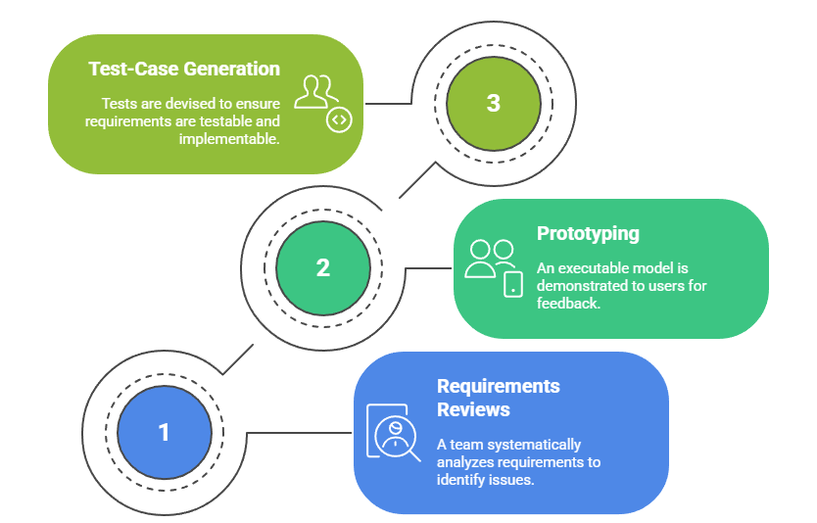

Slide 27
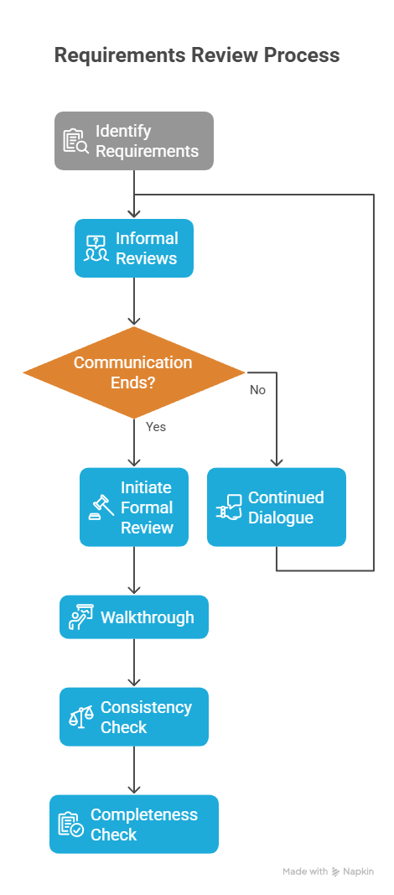
Requirement Review
It is a manual process that involves people from both client and contractor organizations. They check the requirements document for anomalies and omissions. The review process may be managed in the same way as program inspections. Alternatively, it may be organized as a broader activity with different people checking different parts of the document.
      2 type of requirement review:
      Informal reviews simply involve contractors discussing requirements with as many system stakeholders as possible. It is frequently observed that communication between system developers and stakeholders concludes after the elicitation phase, without subsequent confirmation that the documented requirements accurately reflect stakeholder intentions. A significant number of issues can be identified and resolved through continued dialogue with stakeholders prior to initiating a formal review process.
      In a formal requirements review, the development team should 'walk' the client through the system requirements, explaining the implications of each requirement. The review team should check each requirement for consistency as well as check the requirements as a whole for completeness.

Slide 28
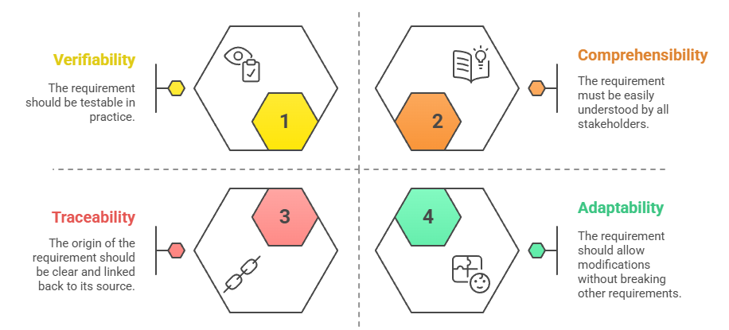
What reviewers checks for during reviewing

Slide 29
05
Requirement
Management

Slide 30
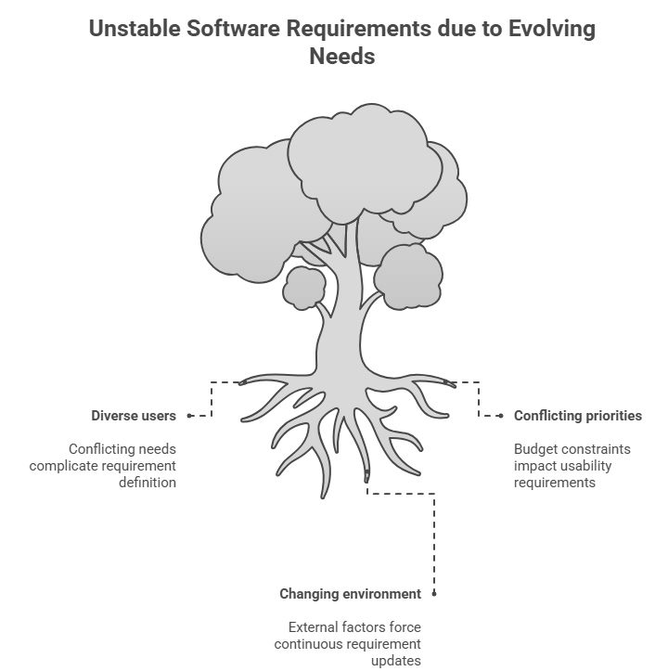
Requirements management is the process of understanding and controlling changes to system requirements. It involves tracking individual requirements, maintaining links between dependent ones, and assessing the impact of changes. A formal change proposal process is established, starting from the elicitation stage.
Requirements for large software systems are always changing because they deal with wicked problems that cannot be fully defined at the start. As development progresses, stakeholders’ understanding evolves, leading to new or modified requirements. After installation, users often discover new needs, and external factors such as organizational priorities, technical updates, or legal regulations also drive changes.

Slide 31
Requirement management planning
For each project, the planning stage establishes the level of requirements management detail that is required. During the requirements management stage, req eng. have to decide on:
Requirements identification : Each requirement must be uniquely identified so that it can be cross-referenced by other requirements and so that it may be used in traceability assessments.
A change management process: This is the set of activities that assess the impact and cost of changes.
Traceability policies: These policies define the relationships between requirements, and between the requirements and the system design that should be recorded and how these records should be maintained.
CASE tool support Requirements: management involves the processing of large amounts of information about the requirements. Tools that may be used range from specialist requirements management systems to spreadsheets and simple database systems

Slide 32
Classification of Volatile Requirement
1. Mutable Requirements:
Change due to changes in the operating environment. In a hospital system, if government policy changes and hospitals must now record vaccination history for all patients, the software must add new data fields.
2. Emergent Requirements
Emerge as customer understanding develops during system design/development. While developing an online learning platform, stakeholders initially ask for video lectures only. Later, they realize students also need discussion forums and quiz features, which emerge during design.
3. Consequential Requirements
Result from introducing the computer system itself. A retail store introduces an automated inventory system. This leads to a new requirement for real-time sales dashboards, since managers now expect instant reporting which wasn’t possible before.
4. Compatibility Requirements
Depend on other systems or business processes. A banking system must integrate with the national payment gateway (UPI/NEFT/RTGS). If the gateway changes its API, the bank’s software must update its compatibility to continue transactions.

Slide 33
End of Chapter

